Slide 1
Report of Stack Overflow Post Questions
Statistics, visualizations, analysis, prediction
Zaid Mohammad, Zhuowen Yan

Slide 2
Abstract
Objective: Analyze Stack Overflow data to identify factors influencing question quality.
Analyzed StackOverflow dataset for trends, patterns, and question quality factors.
Examined attributes like title length, body length, tags, and scores.
Popular tags: Python, JavaScript, HTML; niche tags like windows-shell-extension-menu scored higher.
Used Logistic Regression, Decision Tree, and Random Forest for score prediction; Logistic Regression performed best with SMOTE.
Weak feature-score correlations suggest question quality depends on multidimensional, subjective factors.
Recommendations provided to improve question quality and platform algorithms.

Slide 3
Introduction
StackOverflow Overview:
A global platform for developers to seek solutions, share knowledge, and collaborate.
Hosts millions of questions, forming a vital resource for developers at all levels.
The quality of questions significantly impacts the platform's effectiveness.
Key Questions:
Question Trends: What patterns exist in question characteristics (title length, body length, number of tags)?
Quality Metrics: What attributes influence question scores?
Machine Learning Insights: Can we predict question scores and uncover actionable patterns?
Community Engagement: How can we improve question quality and foster meaningful interactions?
Analysis Approach:
Data Pre-processing: Cleaned and standardized question attributes, filtered valid records, and extracted key features.
Methods Used: Univariate and bivariate analyses to uncover trends, and machine learning models for predictive insights.
Who Benefits? Developers, community moderators, and platform designers.

Slide 4
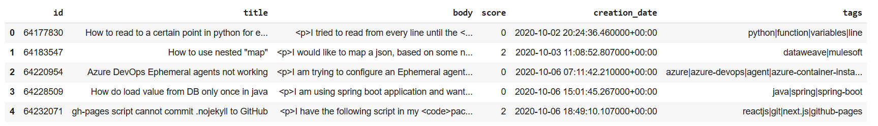
Dataset Overview
Source and Size:
Source: BigQuery Public Dataset.
Dataset: bigquery-public-data.stackoverflow.posts_questions
Dataset Size: 23,000,000 rows and 24 columns.
Sample Used: A subset of 500,000 rows was analyzed for this study, balancing computational efficiency and representativeness.
Key Attributes:
ID, Title, Body, Score, Creation Date, Tags.

Slide 5
Literature Review
Key Findings from Previous Studies
Question Crafting:
Well-crafted, concise questions with relevant tags attract more answers (Asaduzzaman et al., 2013).
Excessive tagging can dilute relevance and reduce engagement (Correa & Sureka, 2014).
Predictive Techniques:
Features like question length, presence of code snippets, and grammar predict quality (Duijn et al., 2019).
Logistic Regression, Decision Trees, and Random Forest models effectively classify question scores, with SMOTE addressing class imbalances (Efstathiou et al., 2018).
Platform Trends:
Decline in average question quality due to competition and saturation of basic topics (Wang et al., 2020).
Suggests the need for improved guidelines and algorithms to maintain quality standards.

Slide 6
Literature Review
Context of Related Research:
Focuses on how question quality impacts community-driven platforms like StackOverflow.
Shows how writing style, using the right tags, and community support help create better questions.
Explains how data analysis and machine learning can improve question quality.
Building Upon Past Research:
Studies what makes questions better using simple statistics and machine learning.
Aims to give helpful tips for users and developers to make questions more useful and engaging.

Slide 7
Architecture
Data Acquisition:
Source: StackOverflow Posts Questions.
Scope: 500,000 questions with key attributes: id, title, body, score, creation_date, and tags.
Project Creation: Created a new project on GCP
Tools: Queried using Google BigQuery and analyzed in Google Colab.
Data Processing:
Steps: Cleaning missing values, standardizing formats, and feature engineering for analysis.
Libraries Used: pandas and numpy for data cleaning, exploration, and transformation.
Data Exploration and Analysis:
Techniques: Statistical summaries, correlation analysis, and visualizations.
Tools: matplotlib and seaborn for histograms, word clouds, scatter plots, and heatmaps.

Slide 8
Architecture
Machine Learning Pipeline:
Models: Logistic Regression, Decision Tree, and Random Forest.
Key Steps:
Class imbalance addressed using SMOTE.
Metrics used: Accuracy, Precision, Recall, F1 Score.
Visualization and Reporting:
Visual Outputs: Word clouds, time series plots, and heatmaps.
Tools: Insights presented through clear and actionable visuals.
Output and Insights Layer:
Deliverables: Actionable insights for StackOverflow question improvement.
Recommendations: Key takeaways to enhance user engagement and content quality.

Slide 9
Methodology
Data Cleaning:
Handled null values to ensure data integrity.
Extracted key features, including:
Word counts for title and body.
Number of tags associated with each question.
Feature Engineering:
Created derived features such as:
title_length (word count in titles).
body_length (word count in body text).
num_tags (total tags per question).
Binned continuous features to improve visualization and interpretation.
Exploratory Data Analysis (EDA):
Statistical Insights: Explored distributions of scores, tags, and body lengths.
Trends Analysis: Examined question volumes and scores over time.
Feature Relationships: Conducted pairwise and correlation analyses to uncover predictive patterns.

Slide 10
Methodology
Model Training and Evaluation:
Baseline Models: Logistic Regression, Decision Tree, and Random Forest were applied to predict question scores.
Class Imbalance Handling: Addressed imbalances with SMOTE for better detection of underrepresented classes.
Evaluation Metrics: Models assessed using precision, recall, F1 score, and accuracy.
Interpretation and Recommendations:
Combined statistical and machine learning results to draw insights.
Provided actionable recommendations to improve question quality and user engagement on StackOverflow.

Slide 11
Data Cleaning
Handling Missing Values:
Check for missing values in the dataset.
Clean Text Data for body Column:
Purpose: Remove unnecessary HTML tags from the body column for cleaner analysis.
Convert Tags into a List Format:
Simplify tag processing by converting the tags column from a string format (separated by |) into a list.

Slide 12
Feature Engineering
Title Length:
Add a new column (title_length) to calculate the number of words in the title.
Body Length:
Add a new column (body_length) to calculate the number of words in the body.
Number of Tags:
Add a new column (num_tags) to calculate the count of tags associated with each question.
Extract Year from Creation Date:
Extract the year from the creation_date column for temporal trend analysis.

Slide 13
Data Visualization and Results
01
How It Changes By Year
Time Series Analysis

Slide 14
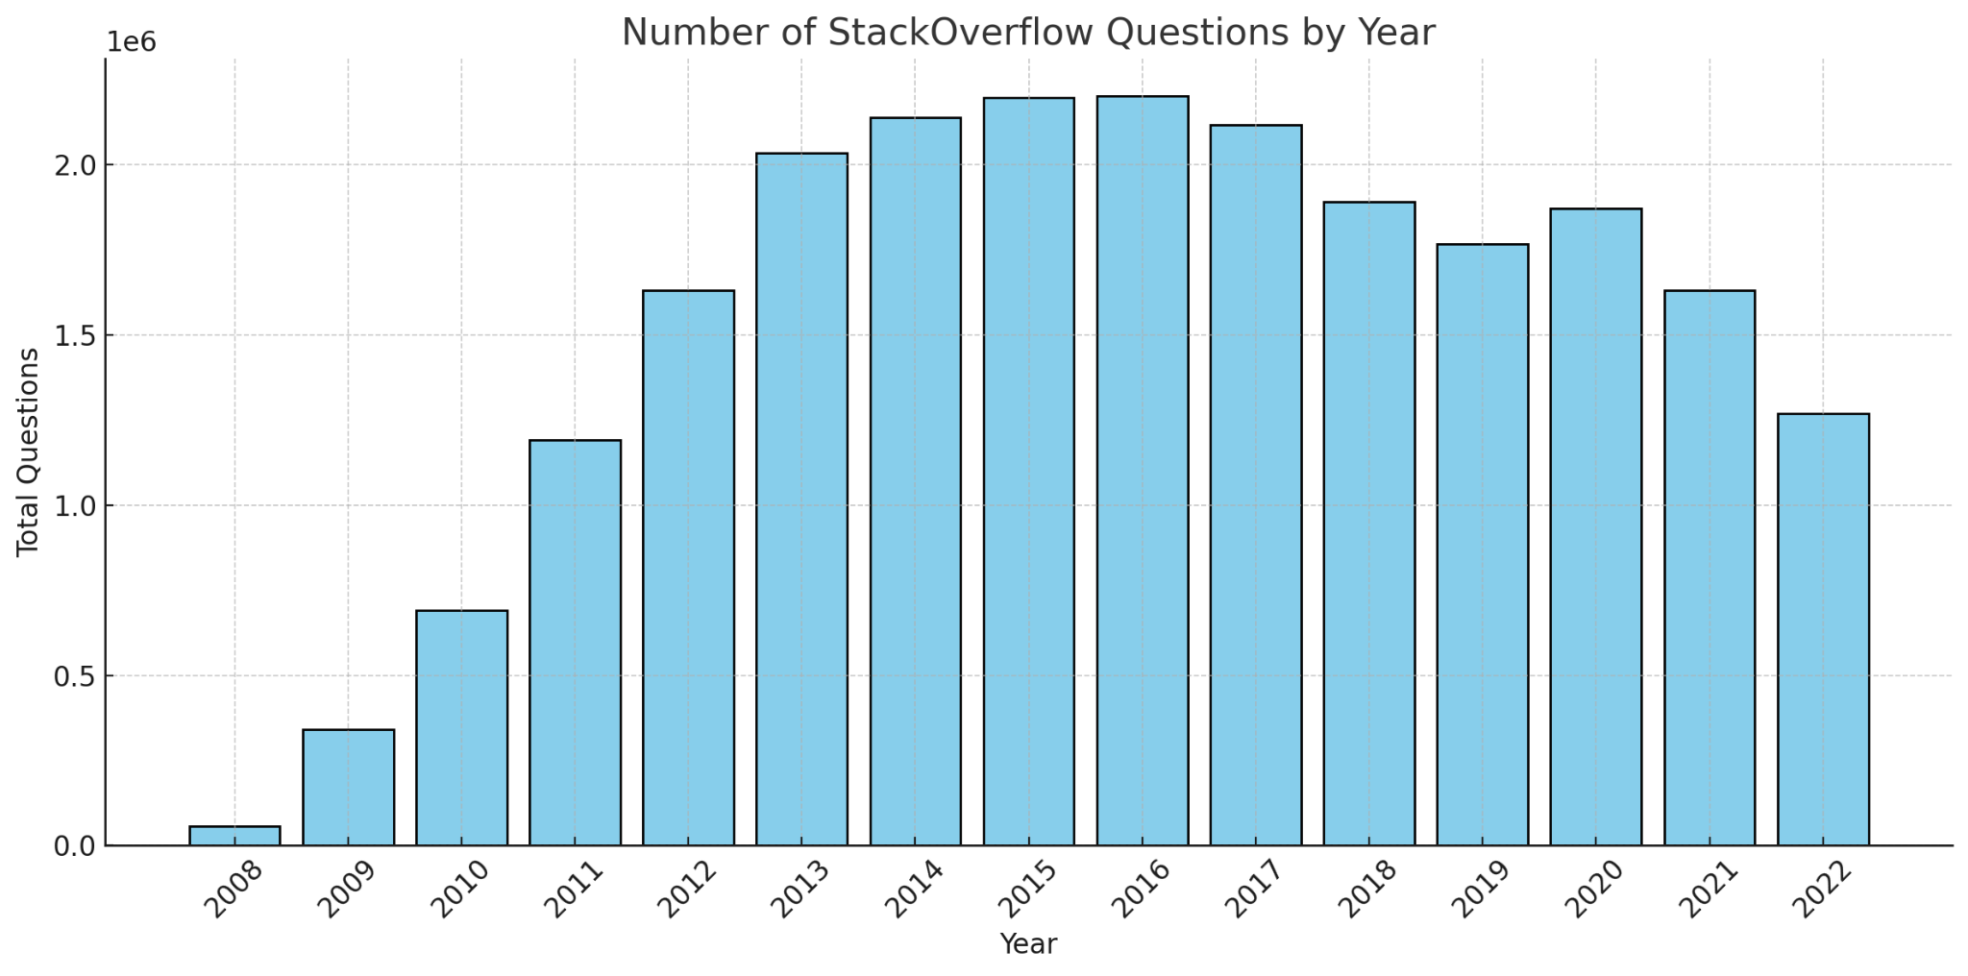
Figure 1.1. Number of Questions Per Year
The number of StackOverflow questions grew rapidly from in 2008 to 2013, reflecting the platform's increasing popularity among developers. Question volumes peaked around 2.2 million in 2015 during the platform's golden era but have steadily declined since 2017 to 2022. This decline is likely due to the saturation of common programming questions and competition from other platforms.

Slide 15
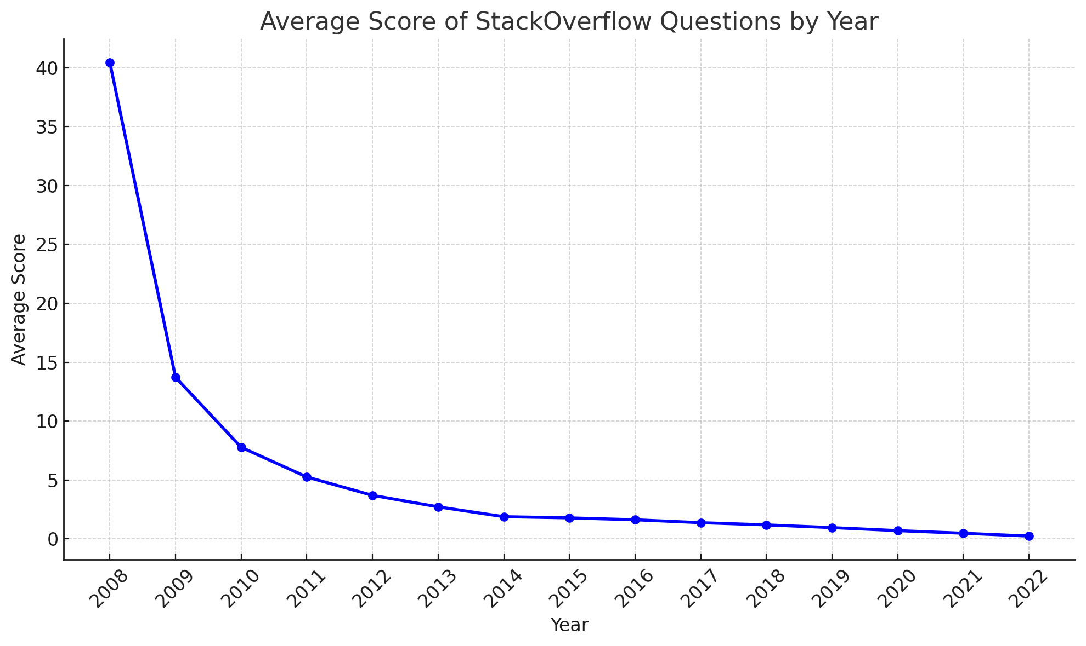
Figure 1.2. Year vs Score
The average score of StackOverflow questions has significantly declined over the years. In 2008, the average score was exceptionally high at 40.46, indicating strong engagement during the platform's early adoption phase. However, this gradually decreased, reaching 0.24 by 2022. The trend suggests reduced voting activity or a shift in user behavior, possibly due to the saturation of common questions, stricter moderation, or a decline in community engagement over time.

Slide 16
Data Visualization and Results
02
Understand Stack Overflow
Univariate Analysis

Slide 17
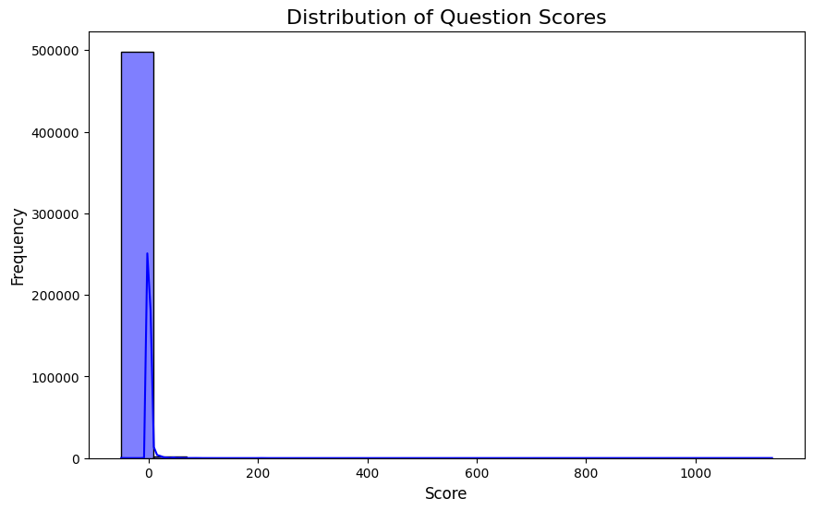
Figure 2.1. Distribution of Score of Questions
The scores of StackOverflow questions are highly skewed, with the majority of scores clustered around lower values (close to 0). Very few questions have exceptionally high scores, indicating that high-scoring questions are rare and likely result from exceptional quality or popularity.

Slide 18
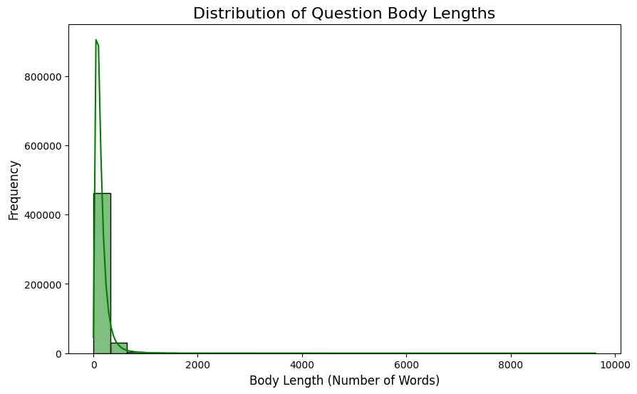
Figure 2.2. Distribution of Body Lengths
The body lengths (in terms of word count) are also highly skewed, with most questions having shorter bodies. There are a few outliers with significantly long question bodies, possibly representing detailed or complex questions.

Slide 19
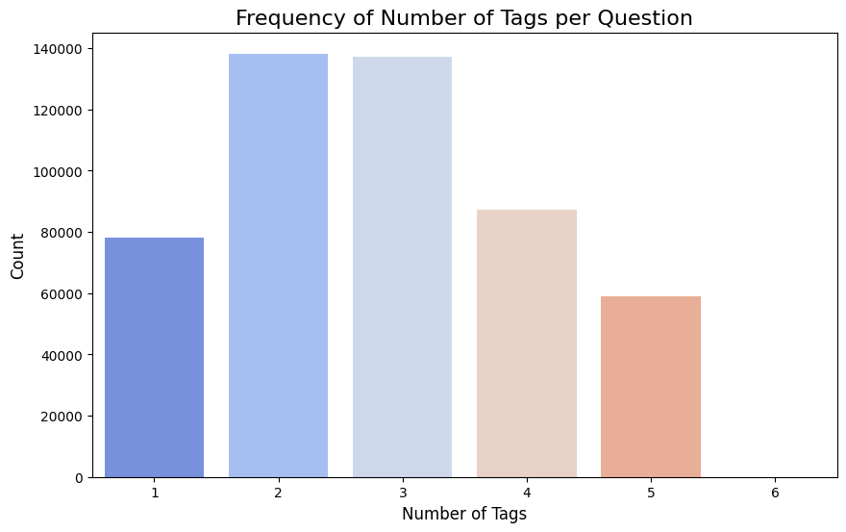
Figure 2.3. Distribution of Number of Tags
Most questions are tagged with 2 or 3 tags, indicating that users tend to use a moderate number of tags to describe their questions. Very few questions have 5 tags, suggesting that excessive tagging is uncommon and likely discouraged.

Slide 20
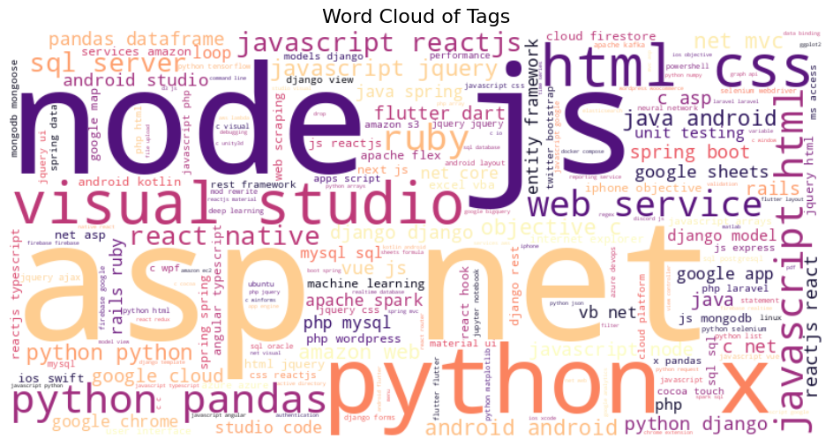
Figure 2.4. Word Cloud of Tags
The most frequent tags include "python", "javascript", "html", "css", "node.js", and "asp.net". Popular frameworks and tools like "reactjs", "django", "pandas", and "spring boot" also appear frequently. The word cloud reflects a strong focus on web development, scripting languages, and commonly used frameworks and libraries in the programming community.

Slide 21
Data Visualization and Results
03
What Affects the Scores
Bivariate Analysis

Slide 22
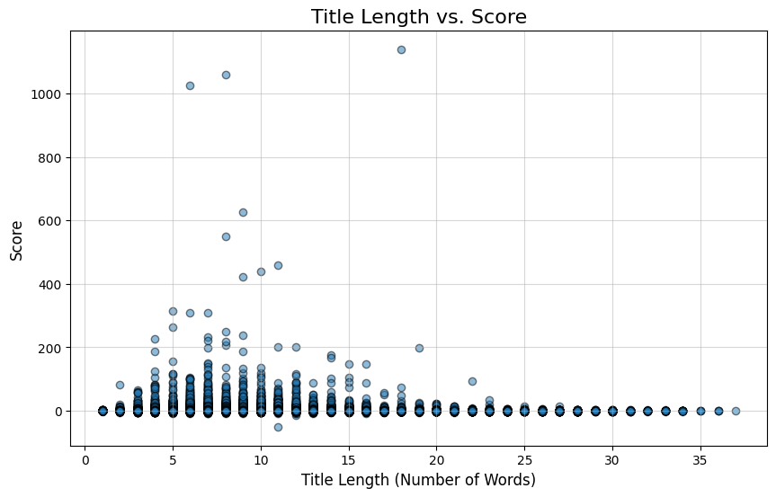
Figure 3.1. Title Length vs Score
Questions with shorter titles (around 5–10 words) tend to have higher scores, indicating that concise titles may attract more attention or better responses. Very long titles (beyond 15 words) rarely achieve high scores, suggesting that overly verbose titles may deter engagement.

Slide 23
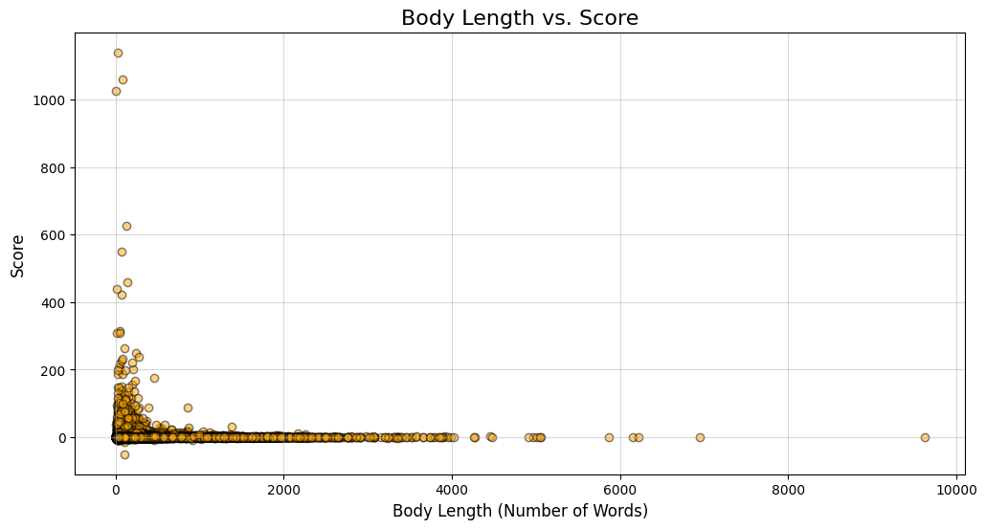
Figure 3.2. Body Length vs Score
Questions with shorter bodies (less than 200 words) tend to cluster around lower scores, but there are a few high-scoring outliers. Longer bodies (up to 1,000 words) exhibit some high scores but are rare, indicating that clarity and conciseness may contribute more to high scores than excessive detail.

Slide 24
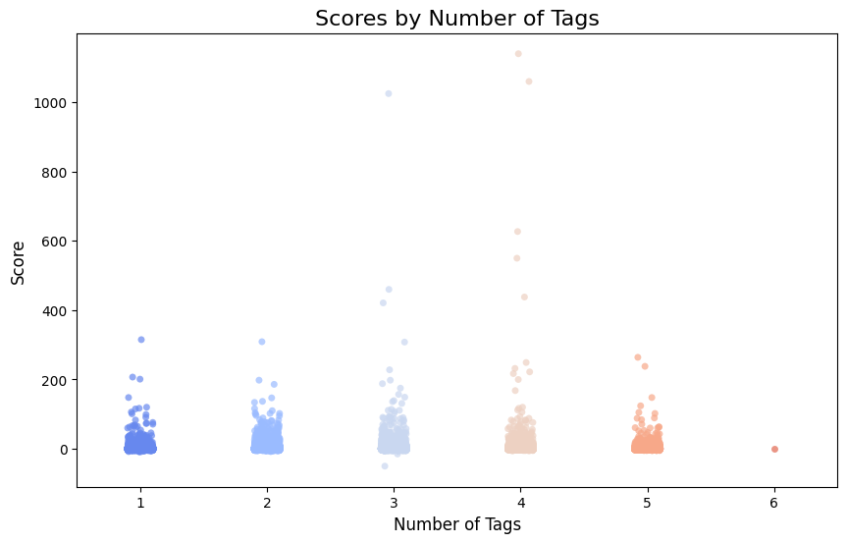
Figure 3.3. Number of Tags vs Score
Most questions with 2–4 tags tend to achieve higher scores compared to questions with only 1 tag. However, questions with the maximum number of tags do not necessarily result in higher scores, suggesting that excessive tagging may not improve question visibility or quality.

Slide 25
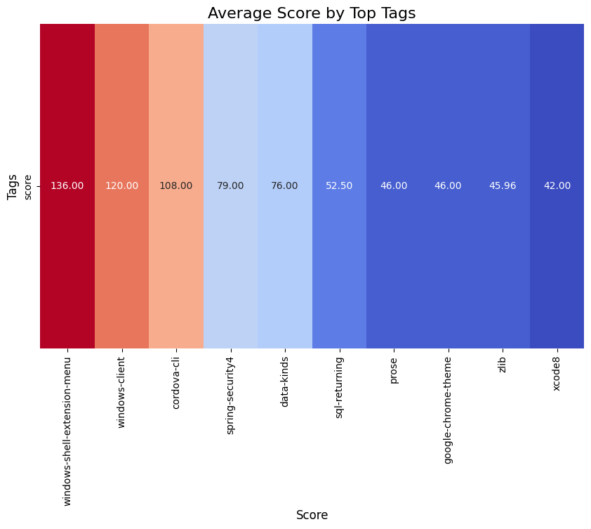
Figure 3.4. Average Score of Top Tags
Tags like windows-shell-extension-menu, windows-client, and cordova-cli are associated with the highest average scores. Niche topics or less saturated tags may attract higher-quality questions and responses, leading to better scores.

Slide 26
Data Visualization and Results
04
Multivariate Analysis

Slide 27
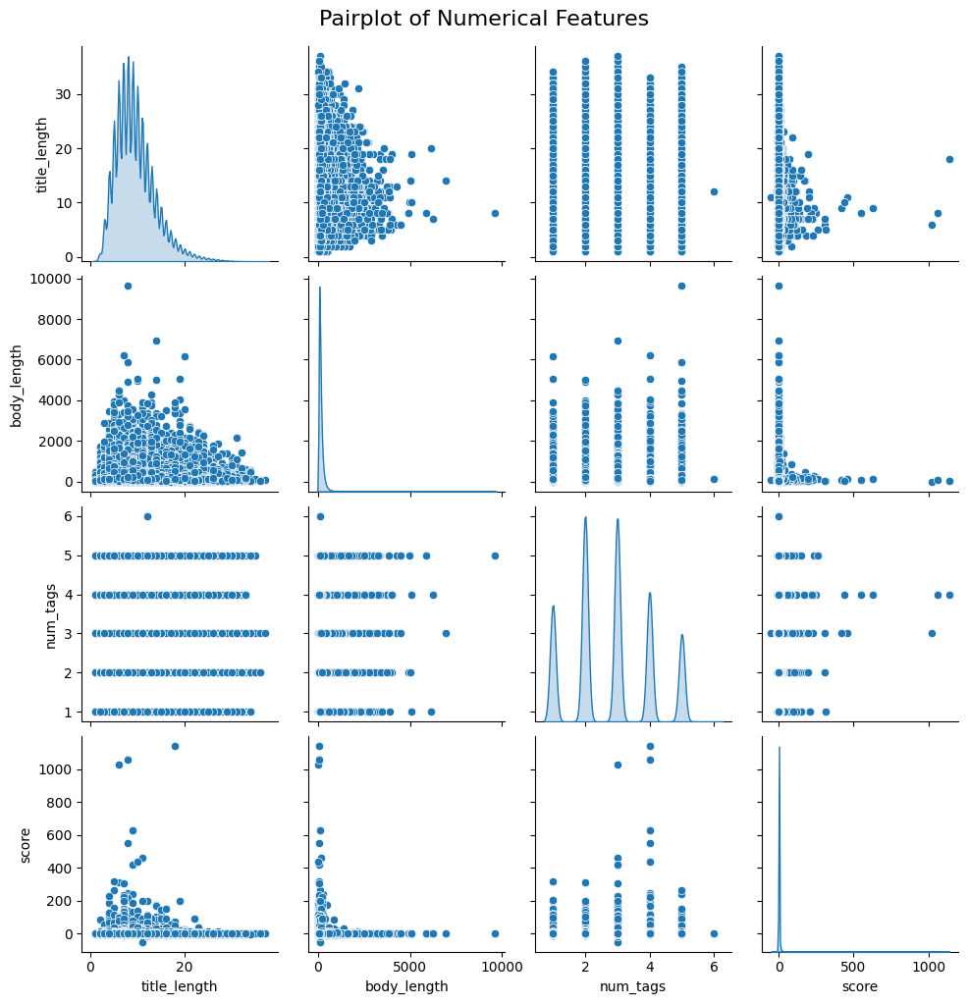
Figure 4.1. Pairplot of Numerical Features
Title Length vs. Score: No strong correlation; high scores favor short/medium titles.
Body Length vs. Score: High scores mostly with shorter bodies; no clear trend.
Tags vs. Score: No noticeable relationship; scores spread across 1–5 tags.
Title vs. Body Length: No significant correlation.
Tag Distribution: Discrete peaks (1–5 tags).
Score Distribution: Skewed towards low scores; few high-score outliers.
Body Length: Mostly short; sharp drop-off for longer lengths.

Slide 28
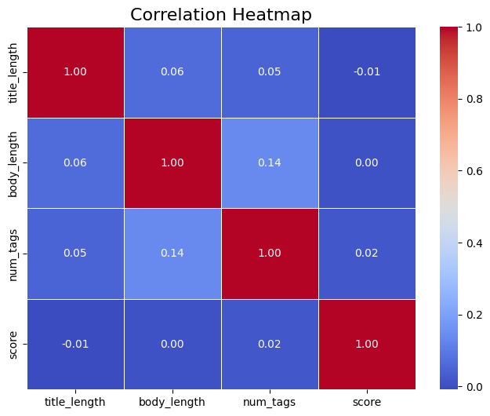
Figure 4.2. Correlation Heatmap
Score:
Correlation with title_length: -0.01 (negligible).
Correlation with body_length: 0.00 (no correlation).
Correlation with num_tags: 0.02 (negligible).
Body Length and Number of Tags: A moderate positive correlation (0.14) exists, suggesting that questions with more tags tend to have slightly longer bodies.
Title Length and Other Features: Weak correlations across the board, indicating no strong relationships with other variables.

Slide 29
Machine Learning

Slide 30
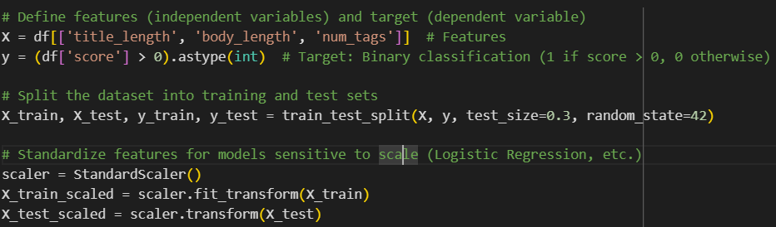
Data Preprocessing for ML
Feature Selection:
Selected independent variables: title_length, body_length, num_tags.
Target variable: Binary classification (1 if score > 0, 0 otherwise).
Dataset Splitting:
Training Set: 70% of the data.
Test Set: 30% of the data.
Used train_test_split with a fixed random state for reproducibility.
Feature Scaling:
Applied standardization using StandardScaler to normalize features.
Scaling ensures compatibility with models sensitive to feature scales (e.g., Logistic Regression).
Outcome:
Generated scaled training and test datasets for reliable model training and evaluation.

Slide 31
Addressing Class Imbalance with SMOTE
Identifying Class Imbalance:
Class 0 significantly outnumbers Class 1.
Imbalance leads to biased model performance favoring the majority class.
Applying SMOTE:
Used SMOTE (Synthetic Minority Oversampling Technique) to generate synthetic samples for the minority class.
Balances the dataset by oversampling Class 1.
Outcome:
Achieved a balanced class distribution in the training dataset.
Improves model's ability to detect the minority class during training.
Class Distribution (After SMOTE):
output:
Class 1: 267136 samples.
Class 0: 267136 samples.
Class Distribution in Target Variable:
score
0 381541
1 118459
Name: count, dtype: int64
Class Distribution After SMOTE:
score
0 267136
1 267136
Name: count, dtype: int64

Slide 32
Logistic Regression
Class Distribution:
Class 0 (majority): 381,541 samples.
Class 1 (minority): 118,459 samples.
Addressed imbalance using SMOTE during preprocessing..
Model Evaluation Metrics:
Accuracy: 55% – Reflects overall correctness.
Precision: 26% – Indicates high false-positive rate for Class 1.
Recall: 49% – Captures nearly half of the minority class instances.
F1 Score: 34% – Balances Precision and Recall.
Detailed Insights:
Class 0: High Precision (78%) but moderate Recall (57%).
Class 1: Low Precision (26%) but better Recall (49%), indicating improved minority class detection.
Classification Report Summary:
Macro Avg (0.52) and Weighted Avg (0.66) reflect the model’s imbalanced class performance.
The model moderately balances minority class detection and majority class accuracy.

Slide 33
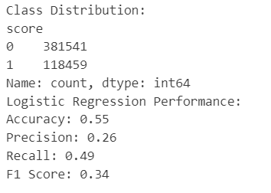
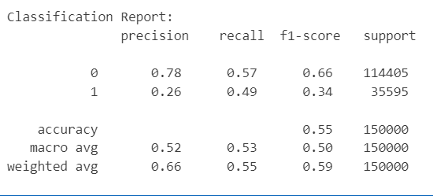
Logistic Regression

Slide 34
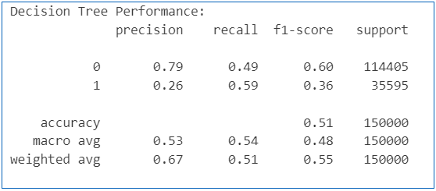
Decision Tree
Model Setup:
Classifier: Decision Tree with a maximum depth of 5.
Class Weight: Balanced to handle class imbalance.
Training Data: Resampled with SMOTE for better minority class representation.
Model Evaluation Metrics:
Accuracy: 51% – Reflects moderate overall correctness.
Precision:
Class 0: 79% – Majority class predictions are more precise.
Class 1: 26% – Indicates many false positives for the minority class.
Recall:
Class 0: 49% – Half of the actual majority class instances are correctly identified.
Class 1: 59% – Better detection of the minority class than Logistic Regression.
F1 Score:
Class 0: 60% – Balances Precision and Recall for the majority class.
Class 1: 36% – Moderate balance for the minority class.

Slide 35
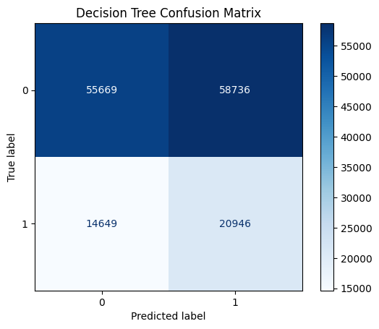
Decision Tree
Classification Report Insights:
Macro Average:
Precision: 53%, Recall: 54%, F1 Score: 48%.
Weighted Average:
Favors the majority class due to class imbalance.
Confusion Matrix:
Visualized to highlight true positives, false positives, true negatives, and false negatives.
Demonstrates the trade-off between detecting Class 0 and Class 1.

Slide 36
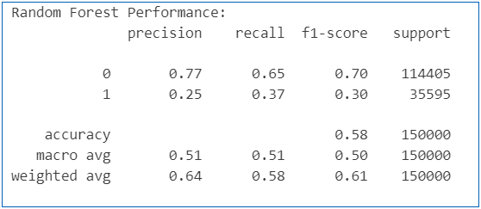
Random Forest
Model Setup:
Classifier: Random Forest with 100 estimators.
Class Weight: Balanced to mitigate class imbalance.
Training Data: Resampled with SMOTE for improved representation of the minority class.
Model Evaluation Metrics:
Accuracy: 58% – Better than Decision Tree but lower than ideal for binary classification.
Precision:
Class 0: 77% – Majority class predictions remain more precise.
Class 1: 25% – Indicates a significant number of false positives for the minority class.
Recall:
Class 0: 65% – Detects most majority class instances accurately.
Class 1: 37% – Struggles to identify minority class instances.
F1 Score:
Class 0: 70% – Good balance for the majority class.
Class 1: 30% – Weak balance for the minority class.

Slide 37
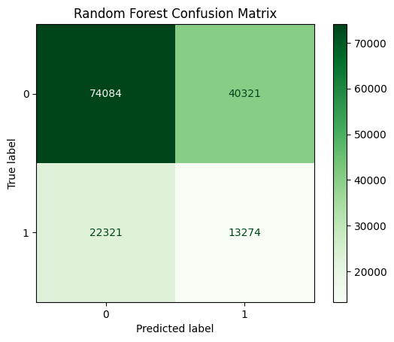
Random Forest
Classification Report Insights:
Macro Average:
Precision: 51%, Recall: 51%, F1 Score: 50%.
Weighted Average:
Metrics favor Class 0 due to the class imbalance, with weighted Precision at 64%.
Confusion Matrix:
Visualized to show how well Class 0 and Class 1 are identified.
Highlights better overall detection for Class 0 compared to Class 1.

Slide 38
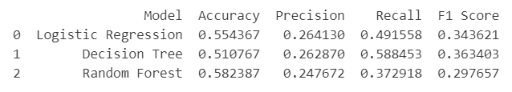
Comparing Model Performances
Why These Metrics Together?
Comprehensive Evaluation:
Accuracy provides a high-level view of performance.
Precision and Recall delve deeper into the handling of positive and negative predictions, especially for minority classes.
F1 Score summarizes the trade-off between Precision and Recall.
Handling Class Imbalance:
In imbalanced datasets, the minority class (1) often gets overlooked.
Metrics like Precision, Recall, and F1 Score ensure that minority class performance is evaluated effectively, avoiding reliance on misleading accuracy.
Accuracy: Percentage of correctly classified samples.
Precision: Ability to avoid false positives.
Recall: Ability to detect true positives.
F1 Score: Harmonic mean of precision and recall.
Output

Slide 39
Comparing Model Performances
Trade off Between Metrics:
Logistic Regression achieves the best balance between Recall and Precision, making it suitable for use cases where both metrics matter equally.
Decision Tree prioritizes Recall and performs the best at detecting the minority class, with a strong F1 Score indicating effective handling of the balanced dataset.
Random Forest maximizes Accuracy but sacrifices Recall and F1 Score, indicating a bias toward the majority class.

Slide 40
Model Recommendations
Choose a Model Based on Objective
Minority Class Detection (High Recall):
Use Decision Tree for its superior Recall and F1 Score. It is best suited for scenarios where identifying the minority class is critical.
Balanced Performance (Recall and Precision):
Use Logistic Regression for a moderate balance, especially if both false positives and false negatives need to be minimized.
Overall Accuracy:
Use Random Forest only if overall Accuracy is prioritized, and minority class detection is less important.

Slide 41
Conclusion
Changes in Questions and Scores by Year:
The number of questions grew rapidly from 2008, peaking in 2015, followed by a steady decline from 2017–2022.
Average scores have declined significantly since 2008, reflecting changes in user engagement, increased competition for visibility, and saturation of common questions.
These trends suggest that while StackOverflow has matured as a platform, maintaining consistent quality and engagement has become a challenge.
Patterns in Question Characteristics:
Questions with concise titles (5–10 words) and focused bodies (up to 200 words) tend to perform better.
Using 2–4 relevant tags increases visibility and engagement, while excessive tagging often leads to diminishing returns.
The structure and clarity of questions are critical for attracting answers and votes.

Slide 42
Conclusion
Attributes Influencing Question Scores:
Popular tags like Python, JavaScript, HTML, and CSS dominate the platform, but niche tags like windows-shell-extension-menu and cordova-cli are associated with higher average scores.
Clarity, relevance, and engagement are subjective factors that heavily influence scores but are difficult to quantify.
Statistical analyses revealed weak correlations between basic features (e.g., title length, tag count) and scores, highlighting the nuanced nature of question quality.
Machine Learning Models for Predicting Scores:
Logistic Regression, Decision Tree, and Random Forest models were evaluated for score prediction.
Logistic Regression with SMOTE performed best, achieving a balance between precision (26.41%) and recall (49.16%), but overall accuracy was moderate.
The limited success of these models underscores the complexity of predicting scores due to the multifactorial and subjective nature of question quality.

Slide 43
Recommendations and Future Directions
Unanswered Questions:
Study why questions go unnoticed and their impact on engagement.
Identify patterns in unanswered questions like tags, complexity, or clarity.
Subjective Quality:
Investigate how clarity, relevance, and expertise influence question quality.
Develop methods to analyze subjective factors impacting question scores.
Advanced Machine Learning:
Test neural networks or ensemble models for better score prediction.
Combine text, metadata, and interactions for improved machine learning performance.
Platform Dynamics:
Explore effects of saturation, user diversity, and visibility changes over time.
Study external influences like alternative platforms or evolving technology trends.

Slide 44
References
1. ‘Answering questions about unanswered questions of Stack Overflow’, 2013 10th Working Conference on Mining Software Repositories (MSR), IEEE, pp. 97–100.
2. ‘Chaff from the wheat: Characterization and modeling of deleted questions on Stack Overflow’, Proceedings of the 23rd International Conference on World Wide Web, ACM, pp. 631–642.
3. ‘Predicting the quality of questions on Stack Overflow using linguistic features’, PeerJ Computer Science, 5, p. e204.
4. ‘Machine learning models for Stack Overflow tag prediction’, Procedia Computer Science, 145, pp. 53–61.
5. ‘Exploring the decline in question quality on Stack Overflow: Trends and solutions’, International Journal of Advanced Computer Science and Applications, 11(1), pp. 214–221.

Slide 45

GitHub
https://github.com/zaidzr3/StackOverflow-Analysis
👆 Click to Visit

